Slide 1
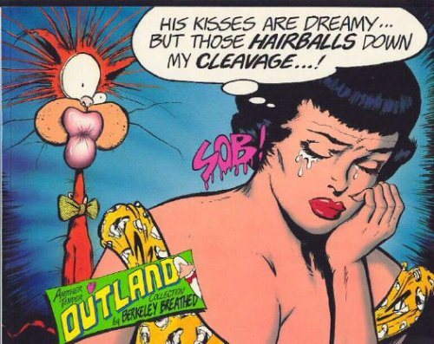
PRIMITIVE
OBSESSION
YOU CAN BEAT IT
WITH HELP FROM TV’S*** “DR* PHIL****”
* Not actually a medical doctor**
** Not actually any kind of doctor at all
*** Not actually on TV
**** Not actually named Phil
Berkeley Breathed, “Outland: His Kisses Are Dreamy”
http://www.goodreads.com/book/show/133032.His_Kisses_Are_Dreamy_But_Those_Hairballs_Down_My_Cleavage_

Slide 2
Primitive obsession?

Slide 3
Primitive obsession?
The habit of using ‘primitive’ types where
more refined types would
provide additional safety or
convey additional information

Slide 4
Primitive obsession?
Symptoms:
Using booleans, especially in six-packs
Using ints or floats for dimensioned units
Using strings for IDs of specific entities

Slide 5
Primitive obsession?
Clinical risks:
Mixing up parameters
Combining incompatible values
Operations that make no sense

Slide 6
Primitive obsession?
DR PHIL HAS THE CURE

Slide 7
Strong typing
Fail at compile time
not at run time

Slide 8
Strong typing
“Make illegal states unrepresentable”

Slide 9
Strong typing
“Make illegal operations unrepresentable”

Slide 10
Strong typing
Encapsulate the representation
Surface the behaviour
Object orientation 101

Slide 11
What is the behaviour of a type?
When are two values equal?
Does it have ordering?
Does it have arithmetic operations?
Does it have custom operations?
How is it consumed/displayed?

Slide 12
What is the behaviour of a type?
If you have to write it,
you have to think about it
* conditions apply

Slide 13
Obsession breaking
Typically value types
Almost always immutable

Slide 14
Obsession breaking
Typically support equality
Limited subset of other operations
Useful to stringise/debugger-display helpfully

Slide 15
Obsession breaking
Delegate most operations to inner value…
except for types

Slide 16
Obsession breaking
Usually have a forgetter for eventual interop

Slide 17
Are YOU tormented by primitive obsession?
DR PHIL* HAS THE CURE
10mg StrongTypes® BP, morning and afternoon
ADMINISTERED BY HAND OR BY ROSLYN
If pain persists, consult a F# developer
* Still not a real doctor. Still not named Phil.

Slide 18
Thanks!
Ivan Towlson
ivan@hestia.cc | itowlson@microsoft.com
@ppog_penguin | http://hestia.typepad.com
github.com/itowlson/primitive-obsession

